Slide 1
Great Patriotic War
Tumanov Igor PS3-41

Slide 11
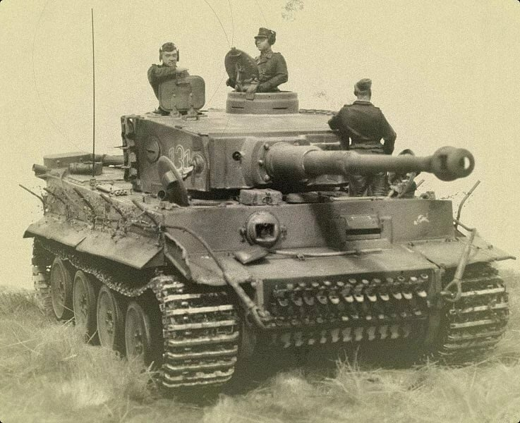

Slide 15
Our Victory is 75 years old

